Slide 1

Intro to Azure Web Apps
Lilian Kasem
Technical Evangelist
likasem@microsoft.com
@liliankasem
Notes:
Hey everyone! I’m Lilian from Microsoft UK and today where going to take a look into web apps which is PaaS and how it removes a lot of the effort and frustrations from hosting a web app.

Slide 2

Deployment
Scale
Traffic
@liliankasem
Notes:
We’re going to be looking at deployment, so how would we take our web application in whatever technology/framework it’s in and deploy that to the web app service.
How that’s then going to scale.
And finally, touching on the traffic manager and how that benefits us

Slide 3


Web Apps
Mobile Apps
Web apps that scale
with your business
Build Mobile apps for
any device
Azure FUNCTIONS
Nano-services that can scale based on demand.
Serverless, event driven experience.
Api Apps
LOGIC Apps
Automate business process
across SaaS and on-premises
Easily build and consume
APIs in the cloud
@liliankasem
Notes:
All sit within app service
Web Apps: Website/app hosting service
Mobile Apps: database in a box, with an API, authentication and notifications
Logic Apps: orchestrate APIs so you can have managed workflows. Workflow designer
API Apps: to wrap up your current API so that it can be consumed by logic apps
Functions: event based compute
implement code triggered by events occurring in other services

Slide 4

What is the Web Apps Service?
@liliankasem
Notes:
Web app hosting service that manages your websites
Different to regular web hosting where there are virtual machines
You’re not thinking about the servers or VMS here,
Service take the code from my website and it will automatically be able to scale that and the management of those machines
Don’t have to think about updates or patches or hardware upgrades

Slide 5



IaaS
PaaS
SaaS
host
build
consume
@liliankasem
Notes:
So when we look at cloud computing, there are really 3 models to think about:
IaaS: hardware, software, servers, storage and other infrastructure components on behalf of its users. IaaS providers also host users' applications and handle tasks including system maintenance, backup and resiliency planning.
virtual server space, network connections, bandwidth, IP addresses and load balancers.
SaaS: software distribution model in which applications are hosted by a vendor or service provider and made available to customers over a network, typically the Internet.
e.g. salesforce or office 365
------------------------------------------------------------
Cloud Upload by Pham Thi Dieu Linh from the Noun Project
tools by Danil Polshin from the Noun Project
Download by Mister Pixel from the Noun Project

Slide 6
Platform as a Service
IaaS
SaaS
host
build
consume
@liliankasem
Notes:
PaaS provides a platform and environment to allow developers to build applications and services over the internet. PaaS services are hosted in the cloud and accessed by users simply via their web browser.
Operating system
Server-side scripting environment
Database management system
Server Software
Support
Storage
Network access
Tools for design and development
Hosting

Slide 7
.NET
Java
PHP
Node.js
Python
@liliankasem
Notes:
And the web app service works across multiple frameworks, so you can deploy your .net, java, php, node, or python web applications to this service, and it will work. And with the web app service it’s good to remember that ultimately this is running on a windows OS box. So anything that can run on Windows (IRS?) can run on this service.
If you’re looking for more traditional hosting of web applications or want to use a linux base, you can easily on azure set up linux virtual machines or use docker containers and all that other good stuff.

Slide 8
Lets talk about deployment
@liliankasem

Slide 9

@liliankasem
Notes:
So… I’m not sure if you’ve heard of this phrase “it works on my machine”, I know certainly I’ve used it a lot when working on applications. You build an app or put together a website and you give it someone else and they say “it doesn’t work; I can’t get it to build”

Slide 10
Get it off the developer’s machine
@liliankasem
Notes:
It’s generally a good idea to host your application as you build it
Web app use not just for production. Get it off devs machine, get it out there and share it with the team.
When you deploy, you also get a HTTPS endpoint
deploy as frequently as you commit to your source control.

Slide 11
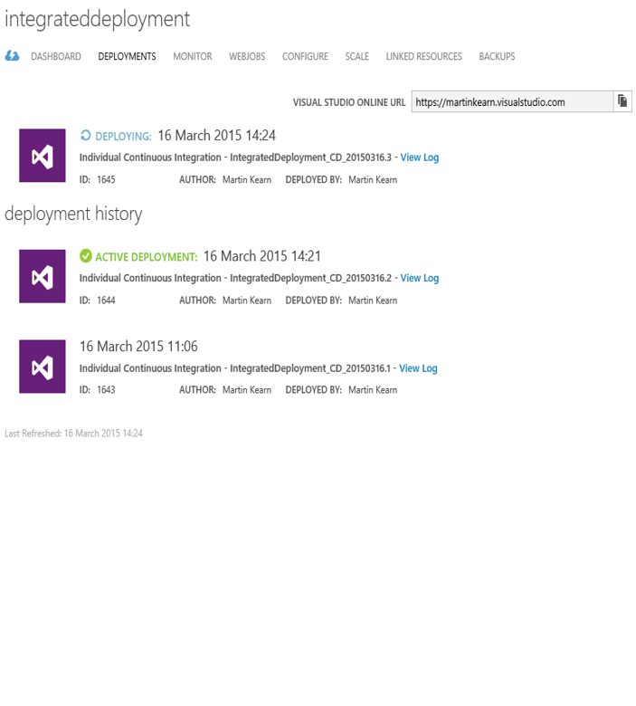
Continuous Deployment
Deploy from source control
VSTS, GIT, GitHub, BitBucket, etc.
History, rollback, roll forward
@liliankasem
Notes:
One of the easiest things to set up on this is continuous deployment.
what happens when you setup with something like github, when you check into github, that sends a web put service request to azure – azure goes to the github system, pulls the latest repo and deploys that to a current deployment slot.

Slide 12
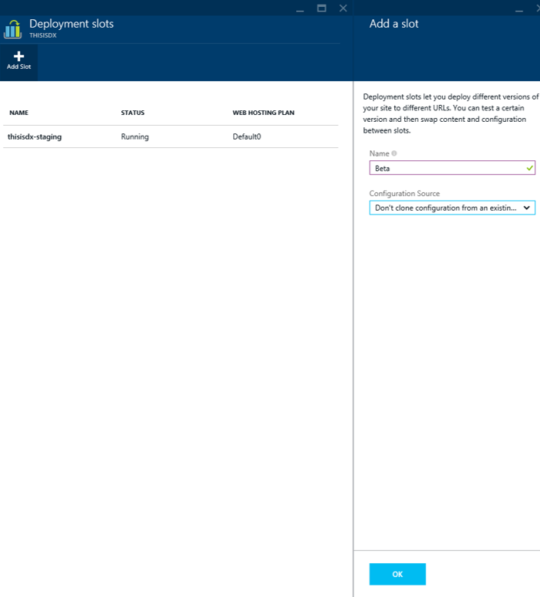
Deployment Slots
Multiple live versions of your site
Staged deployment, A/B testing
Swap and rollback
@liliankasem
Notes:
basically like standalone web app applications
up to 10 of them in a single web app and they are individual separate websites
contain different branches of your project
different versions of your website
different projects all together
Hot swap them
Swap to newer version of deployment
Go live
Staged deployment – A/B testing
20:80 or even 50:50
Use analytics to see which version works best
Easy swap to previous deployment or roll back changes from a git commit (Redeploy old git commit)

Slide 13
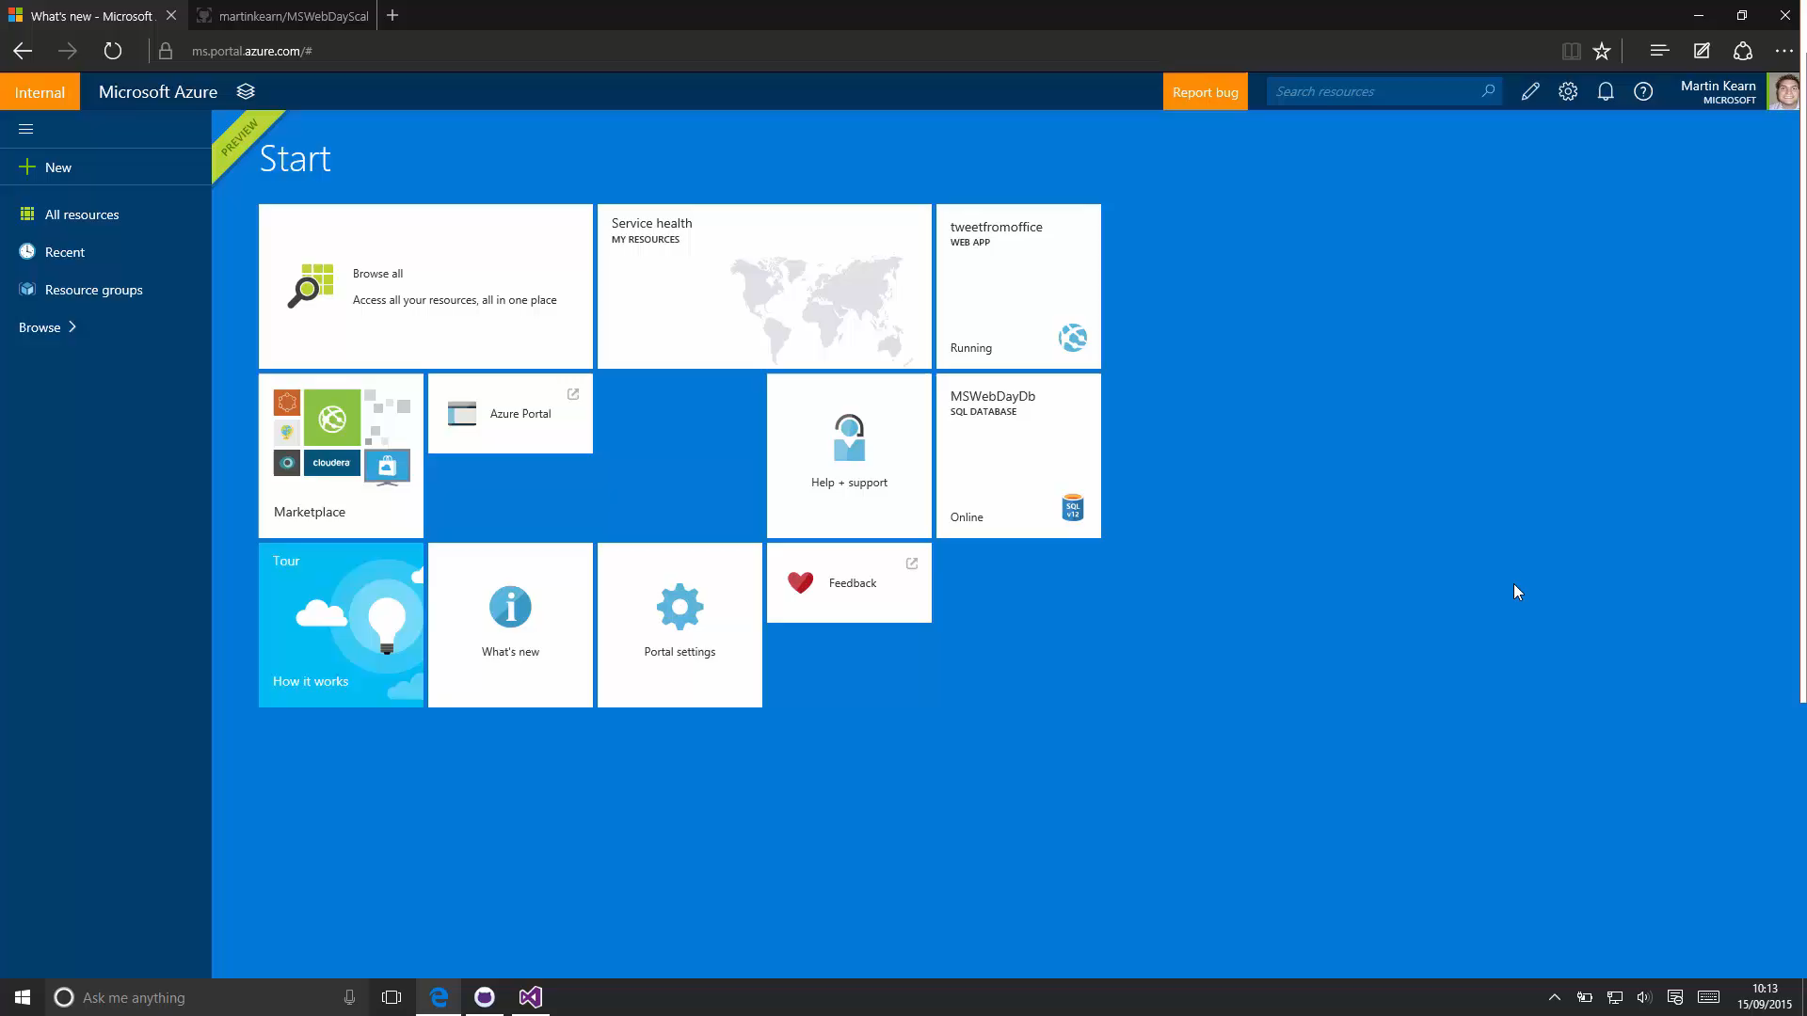

Slide 14
Lets talk about scale
@liliankasem
Notes:
And one of the reasons you’d want to use something like a PaaS service is that we would want to scale that service.

Slide 15
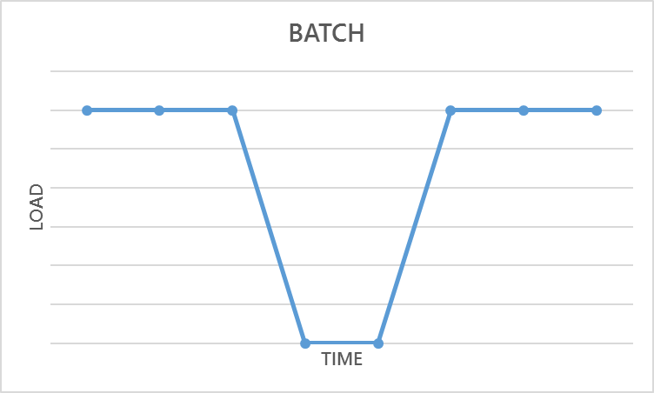
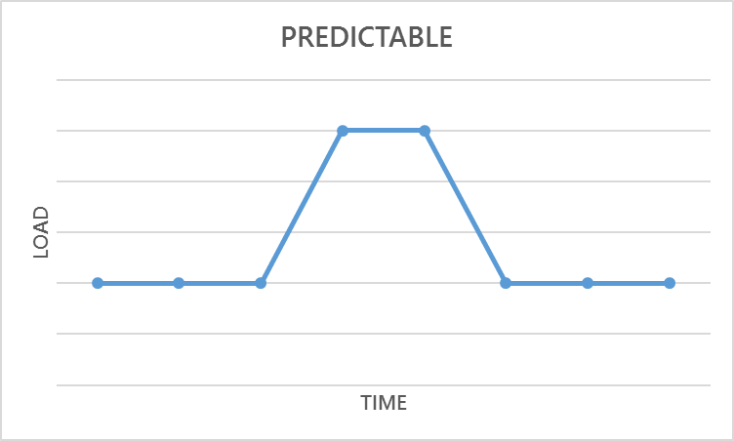
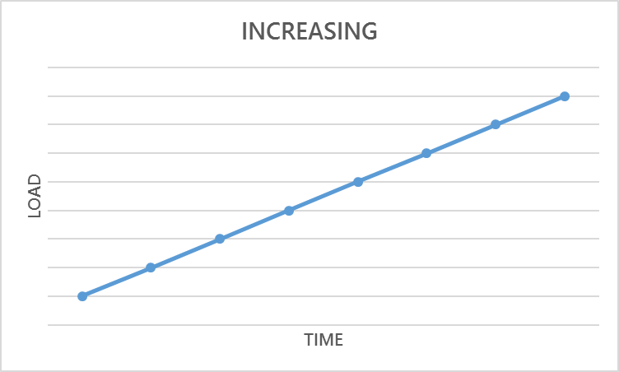
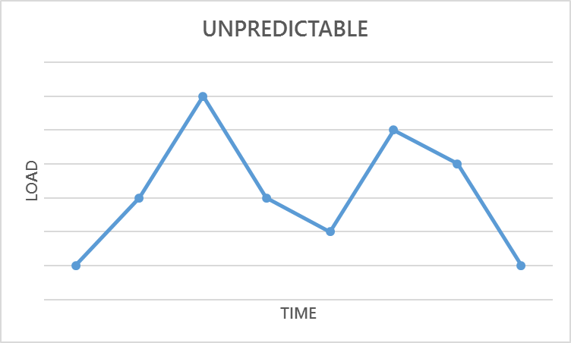
Notes:
Batch: a ton of traffic at a time and then none, and then high volumes of traffic
Predictable: when you have a position in time where you know there will be a specific things that might happen so you might have a lot of traffic mon-Friday and little on weekends
Increasing: so like your site becoming popular over time and it constantly grows
Unpredictable: cant predict the seasonality
PaaS service is great with that because you don’t need to worry about how many servers youre going to need for your website, all you know is that you have a service where regardless of the requirements its going to be able to grow and scale with that.

Slide 16
Scale Up
or
Scale Out
Scale up
Make your servers bigger
Scale out
Add more servers
@liliankasem
Notes:
So you can either scale up or scale out.
And when we say scale up we mean make your server(s) bigger and more powerful.
And when we say scale out we mean adding more servers of the same scale.
And that’s not to say you can’t do both, you absolutely can both scale up and out.

Slide 17

AutoScale
Notes:
How does it work, well when users access your web application and traffic starts to grow

Slide 18
AutoScale
Notes:
Your instances start to grow with it

Slide 19
AutoScale
Notes:
And it keeps growing and spinning up instances to handle all of the incoming traffic to ensure your site doesn’t go down. And as traffic and users start to leave your site and numbers decrease, the instances come down too so that only what is needed, and a little extra as contingency, is being consumed. And you only pay for what you use.

Slide 20
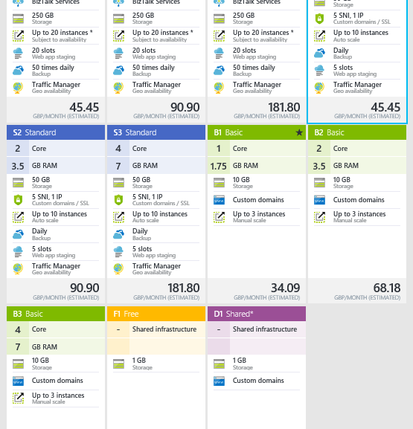
Scale Up with Tiers & Sizes
Free
Shared
Basic
Standard
Premium
@liliankasem
Notes:
And in azure you can scale up with tiers and sizes. There are 5 different tiers and each one is more powerful than the last:
Free cant customise domain name
Premium larger machines, more cores, more ram
Standard tier or higher to enable auto scale, traffic manager and multiple deployment slots

Slide 21
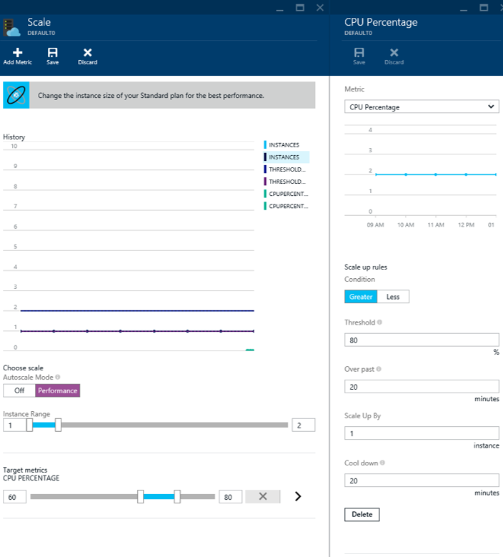
Scale Out With AutoScale
Automatically
Scale by CPU or Schedule
Pay for what you use
@liliankasem
Notes:
And you can let the web app service deal with scaling out for you with autoscale.
You can easily do this manually but setting up the automatic scaling service does help.
You can set it up to scale automatically when you hit a certain CPU limit that you can set.
Or you can scale based on a schedule, so if you know you won’t be getting any hits on your website between 11pm and 10am, or that you know at 3pm you somehow have a crazy amount of traffic every day, you can schedule the service to scale out every day at 3pm.
Scale out = creating more instance of your server.

Slide 22
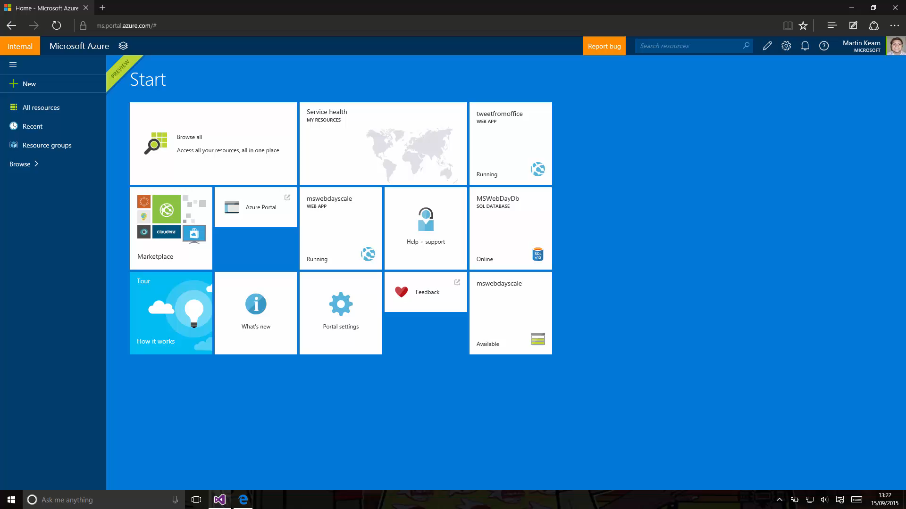

Slide 23
Lets talk about traffic manager
@liliankasem
Notes:
three options for traffic routing:
failover: one primary endpoint but have backups incase primary endpoint is unavailable
Performance: multiple endpoints (different geo locations) – send clients to closest endpoint for low latency
Weighted round robin: distribute load across a set of endpoints in the same datacenter or across different datacenters

Slide 24
Traffic Manager
Performance
Weighted Round-Robin
Failover
@liliankasem
Notes:
three options for traffic routing:
failover: one primary endpoint but have backups incase primary endpoint is unavailable
Performance: multiple endpoints (different geo locations) – send clients to closest endpoint for low latency
Weighted round robin: distribute load across a set of endpoints in the same datacenter or across different datacenters

Slide 25
Intelligent customer routing with Traffic Manager
www.yourapp.com
Notes:
Routing to new location if there is a failure (failover)
Routing to area with lowest latency (performance)
Load distribution (round robin)

Slide 26
Intelligent customer routing with Traffic Manager
www.yourapp.com
Notes:
And if one of your web application regions does down, they are automatically rerouted to another region that is up with no downtime.

Slide 27
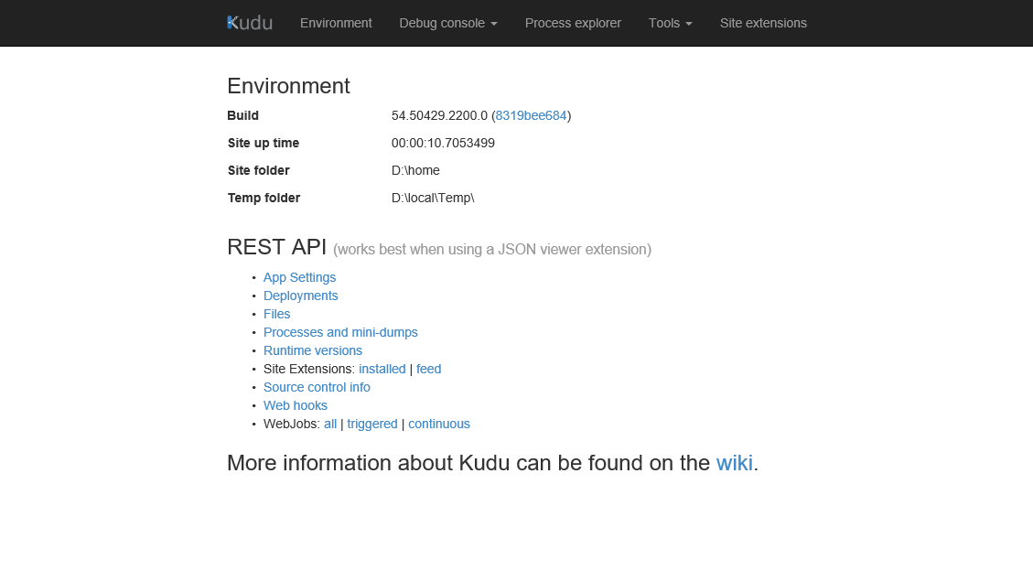
@liliankasem
Notes:
Kudo – engine manages the web app. Switching deployments etc. kudo enables all of that
Live monitoring app using this api

Slide 28
Deployment
Scale
Traffic
@liliankasem

Slide 29

Call to Action
The demos
github.com/liliankasem/deploymentslots
Sign up and get started today for free at
azure.com
Contact me
@liliankasem
likasem@microsoft.com

